Slide 1
Electro-Static Discharge (ESD) Awareness

Slide 2
Contents
Introduction to ESD
Impacts of ESD
ESD Control
Protecting from ESD
Summary

Slide 3
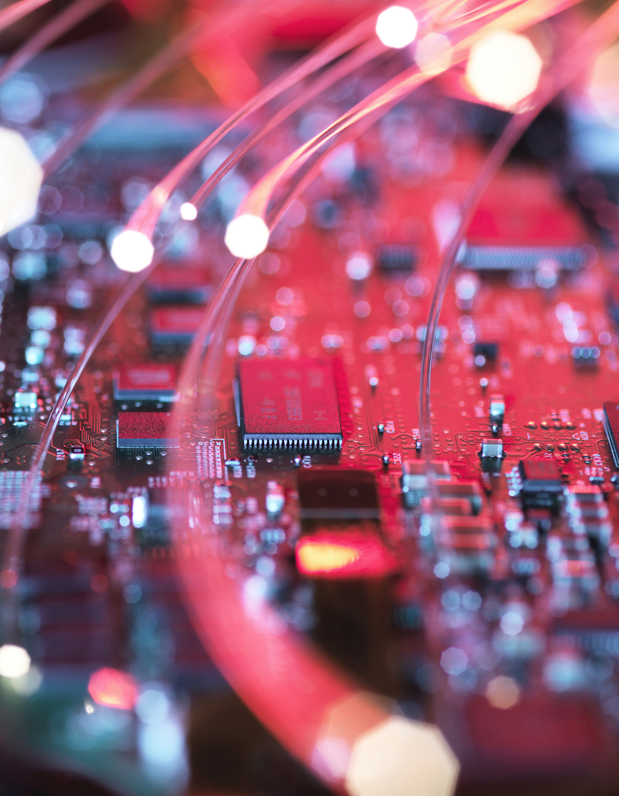
Introduction to ESD

Slide 4
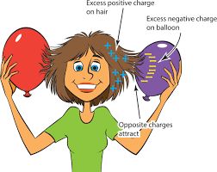
What is ESD?
Electrostatic Discharge, commonly known as ESD, is a sudden and momentary flow of electric current between two objects.
This usually occurs when the objects are brought close together or when the dielectric (an insulating material) between them breaks down, often resulting in a visible spark.

Slide 5
How is ESD created?
Walking on Carpet: The friction between shoes and carpet can cause a build-up of static charge on a person.
Removing Clothing: Synthetic materials can create a significant amount of static when they comes into contact with skin or other fabrics.
Touching Objects: When a charged person touches an object with a different electrical potential, the static can discharge, resulting in ESD.

Slide 6
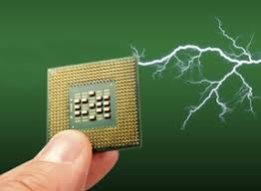
Impacts of ESD

Slide 7
How ESD damages electronics?
Shorting: ESD can create a conductive path between two points in a circuit that should not be connected, leading to a short circuit1.
Over-Powered Components: Many electronic components are designed to handle specific voltage levels. ESD can exceed these levels, overloading the components and causing damage from the inside out1.
Heat Damage: The rapid release of energy during an ESD event can generate enough heat to physically damage the internal structure of electronic components1.
The damage caused by ESD can be immediate or may not manifest until later, potentially leading to device failure weeks or months after the ESD event. This is why ESD protection measures are critical in environments where electronic components are manufactured, handled, or used

Slide 8
Cost on Companies due to ESD
ESD has significant cost implications for industries, particularly those dealing with electronics and sensitive components.
Direct Damage Costs: ESD can cause immediate damage to electronic components, leading to the need for repair or replacement. This can be costly, especially for high-value components
Indirect Costs: ESD damage can result in production delays, increased labor for rework, and additional quality control checks. These indirect costs can add up quickly and impact the overall operational efficiency
Warranty and Liability: Products damaged by ESD and shipped to customers can lead to warranty claims and potential liability issues. This not only has financial repercussions but can also harm a company’s reputation

Slide 9
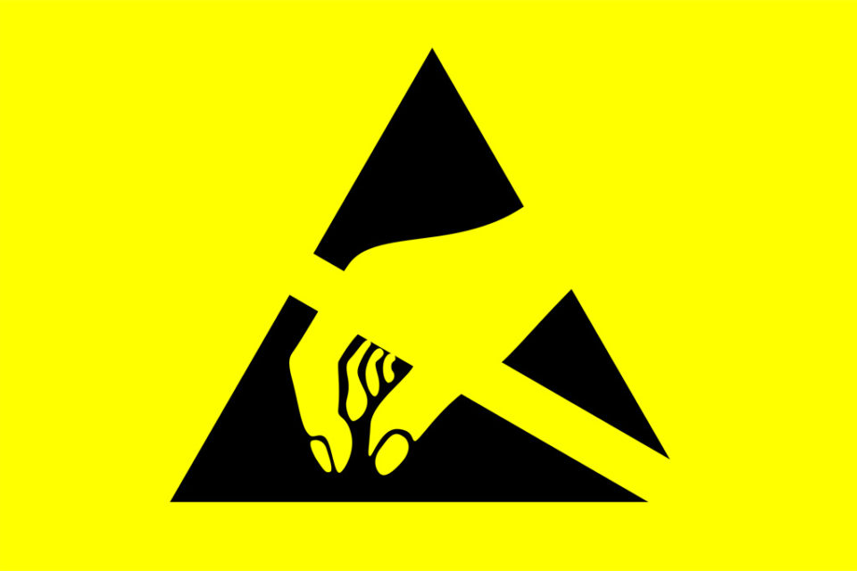
Protecting from ESD
This Photo by Unknown Author is licensed under CC BY-SA

Slide 10
How to prevent ESD?
Antistatic and ESD Clothing: ESD smocks, jackets, and lab coats designed to prevent static build-up.
Footwear: Antistatic shoes or heel straps that reduce static electricity accumulated from walking. Footwear with low electrical resistance to facilitate charge dissipation.
Hand Protection: Antistatic gloves to handle ESD-sensitive components without causing damage. Gloves that maintain dexterity while providing ESD protection.
It takes less than 100 Volts to damage electronic components, but humans generate between
3000 – 3500 volts by just walking.

Slide 11
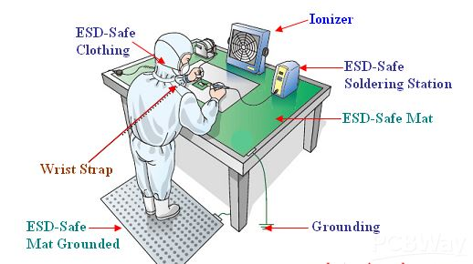
Are you grounded?
Stand on ESD-Safe mat
Use Wrist Strap while working
Ensure tables/chairs are grounded
Perform grounding check before entering EPA

Slide 12
Reminders
Grounding
Grounding: Use wrist or heel straps to ground yourself at all times.
Ensure
Equipotential Bonding: Ensure all conductive surfaces are connected to a common ground.
Opt
Static Minimization: Opt for materials and processes that limit static generation.
Wear
PPE Usage: Wear ESD-safe garments, such as lab coats or smocks, to prevent static buildup.
Testing
Regular Testing: Perform consistent checks on ESD control systems for effectiveness.

Slide 13
THANK YOU
Brita Tamm
502-555-0152
brita@firstupconsultants.com
www.firstupconsultants.com

